Slide 1
Assignment 3

Slide 2
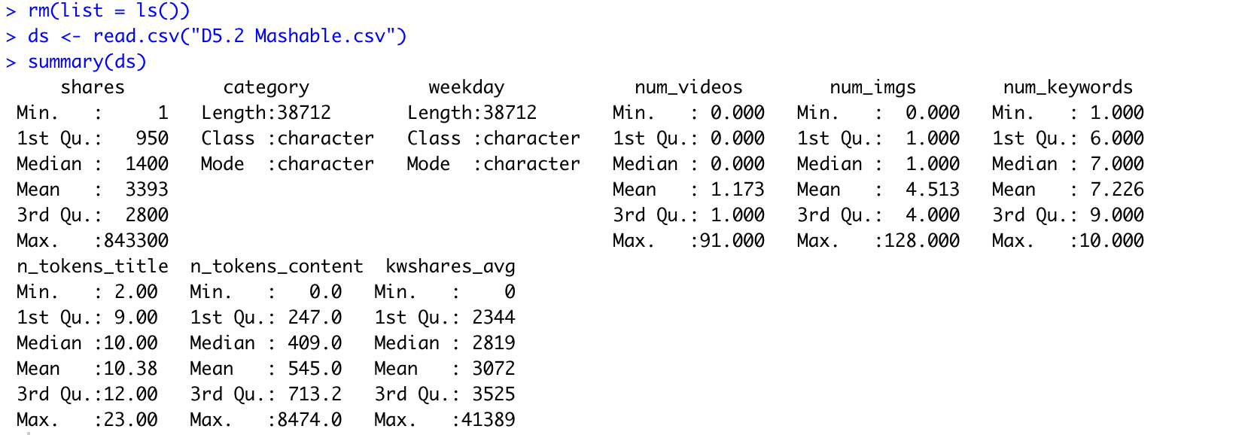

Slide 3
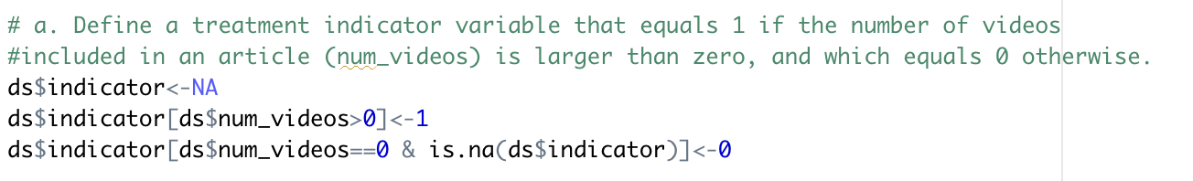
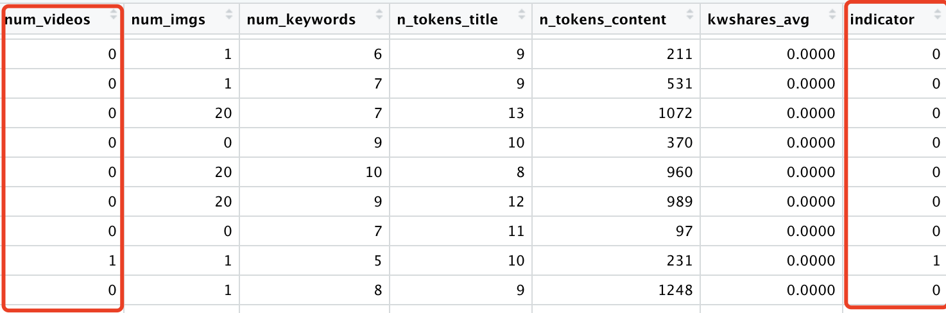
We use the variable named indicator to let the data with number of videos equal to zero to be 0, and not equal to zero to one. And it can be seen for our treatment variable.

Slide 4
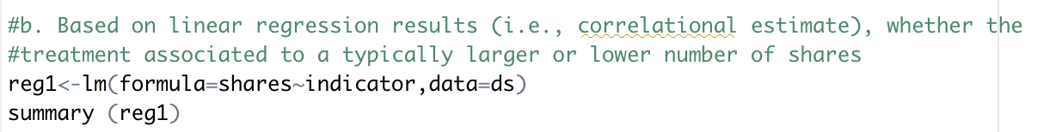
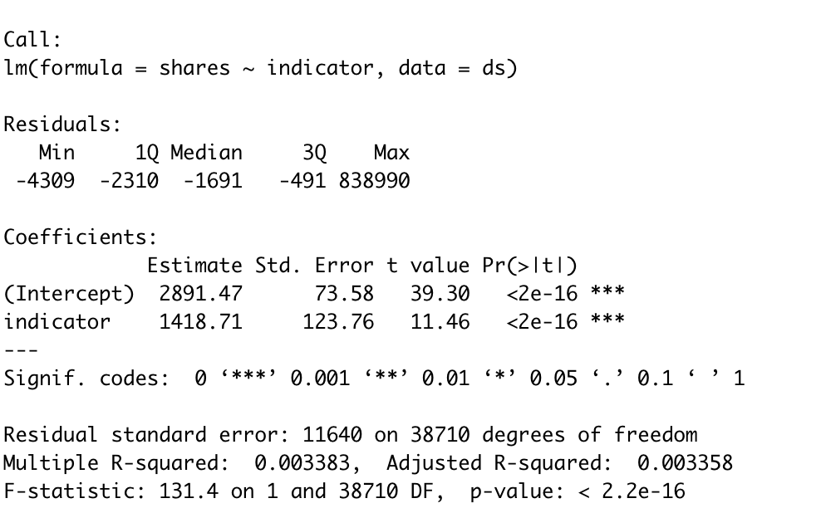
Drawing from the p-value of 2e-16, which smaller than 0.05, there is significant correlation between share and video numbers. Since the coefficient is 1418.71, which means the treatment associated to a larger number of shares

Slide 5
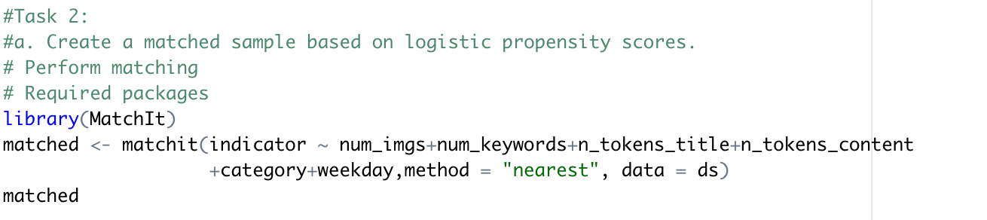
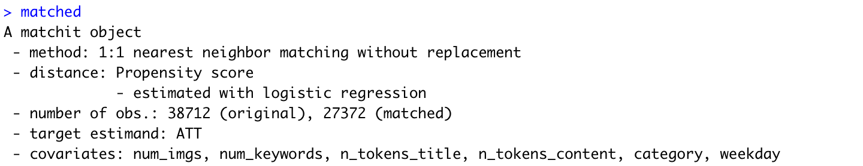
Perform task 2: (i)estimate pscore, (ii)match treatment based on pscore
Model/ specification used to estimate the propensity score
Equally split treated/ non-treated

Slide 6
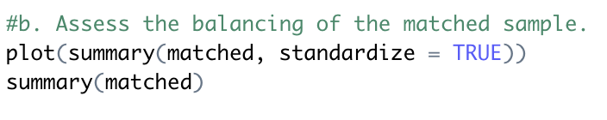
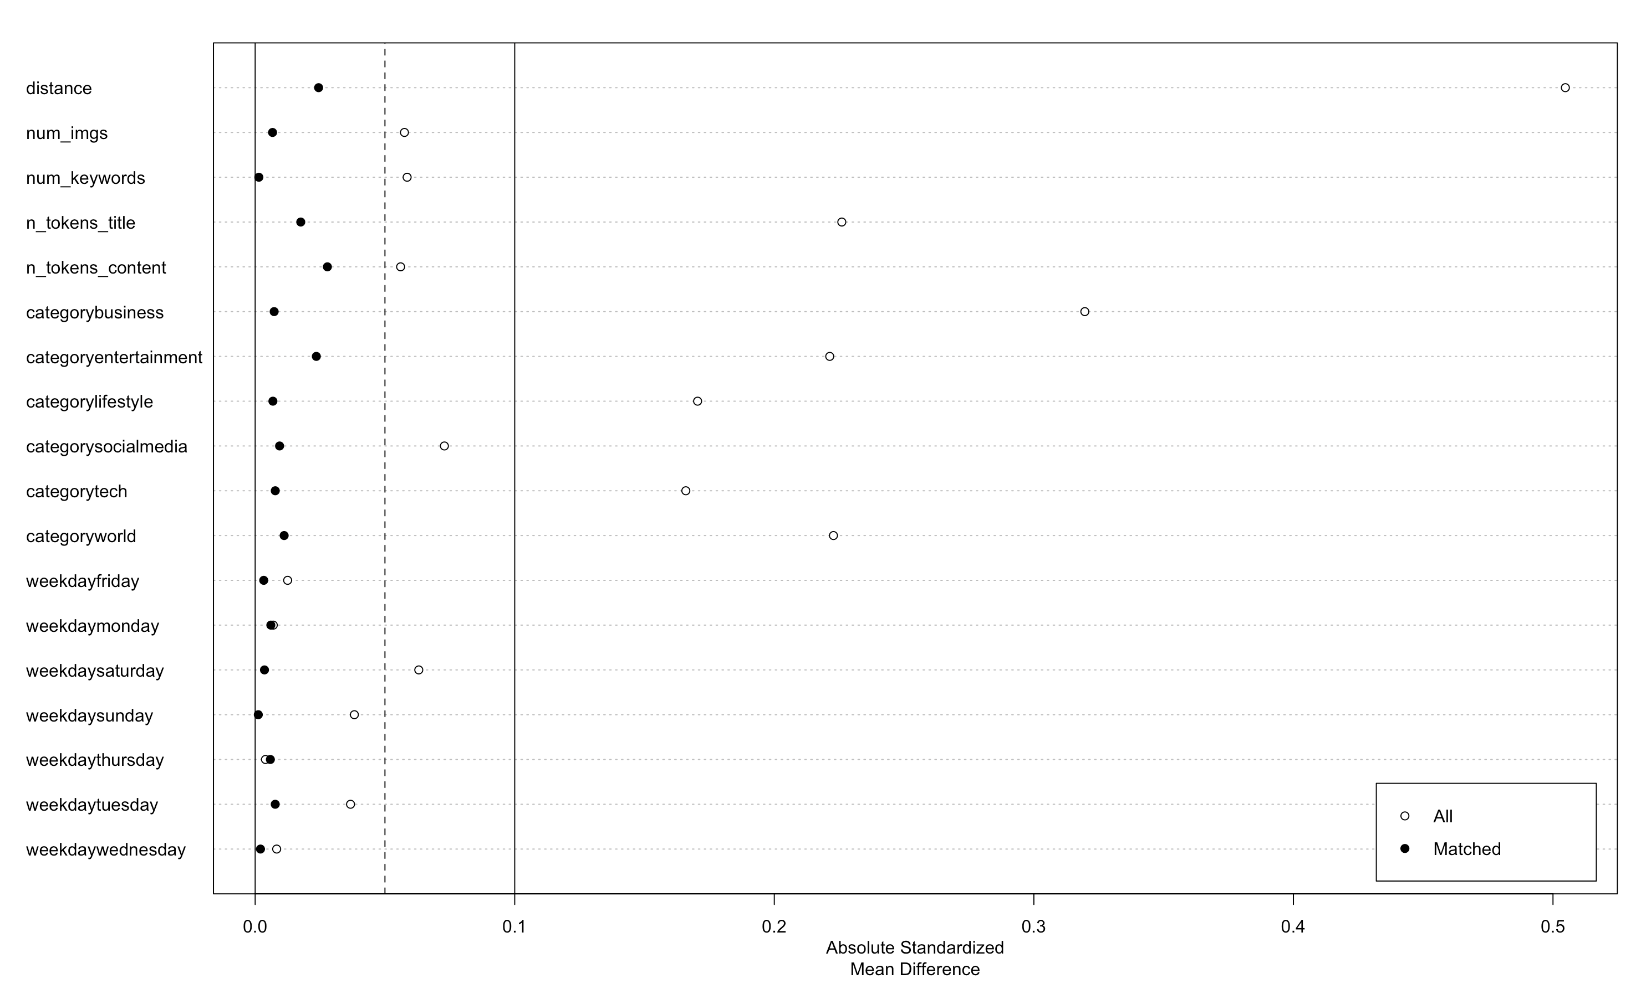

Slide 7
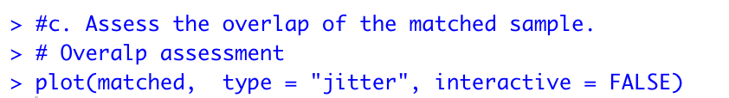
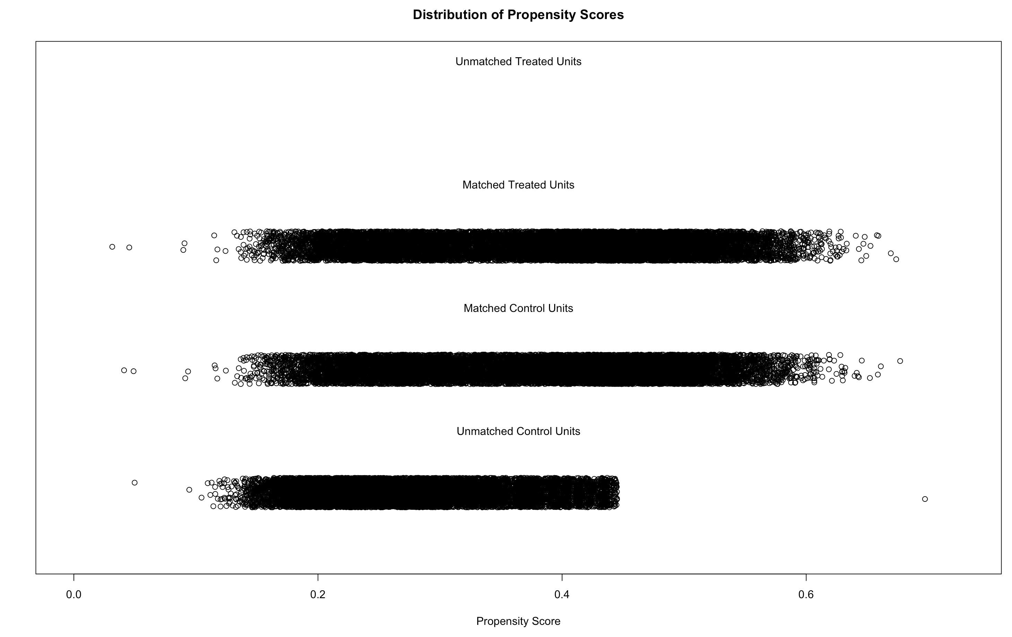
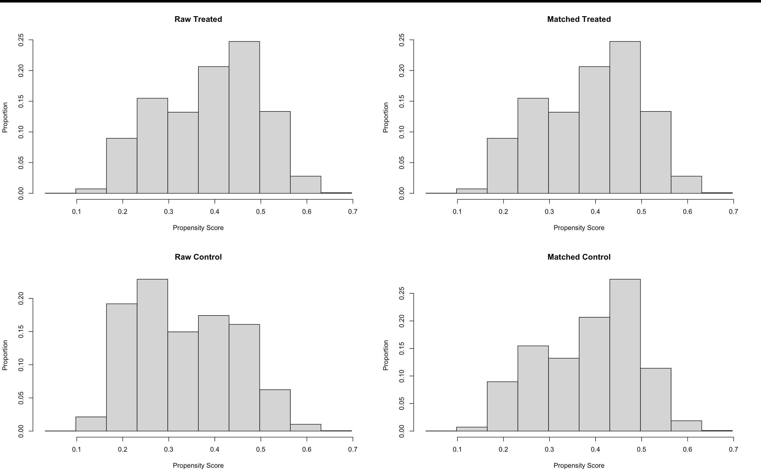
Week overlap area
The first graph shows that matched treated and control observations have good overlap for pscores<=.5. After this range, overlap becomes a little weak. We will use this observation to test the robustness of our ATE estimates.

Slide 8
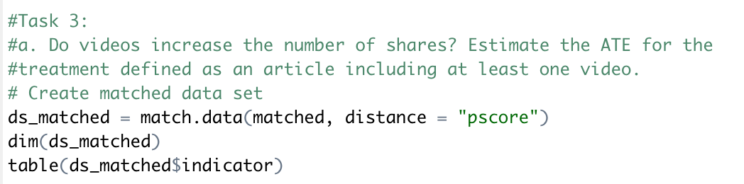
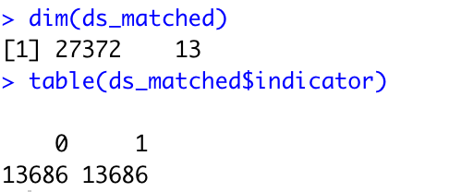
Here, we creates a column with pscore values. We have added the second argument to create a column containing pscores (these will be needed to test robustness with respect to weak overlap). The following statistics tell us that the resulting (matched) sample contains 27372 observations, equally divided between treated and control observations.

Slide 9
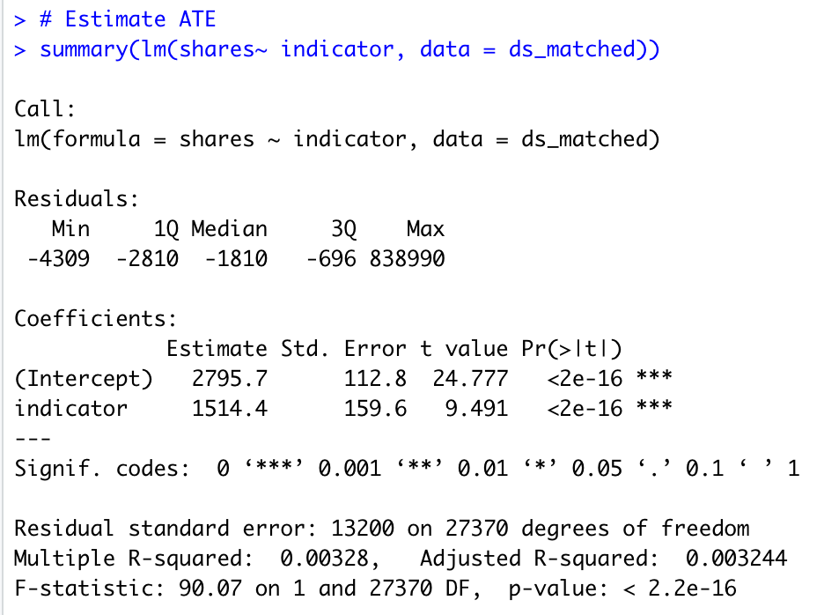
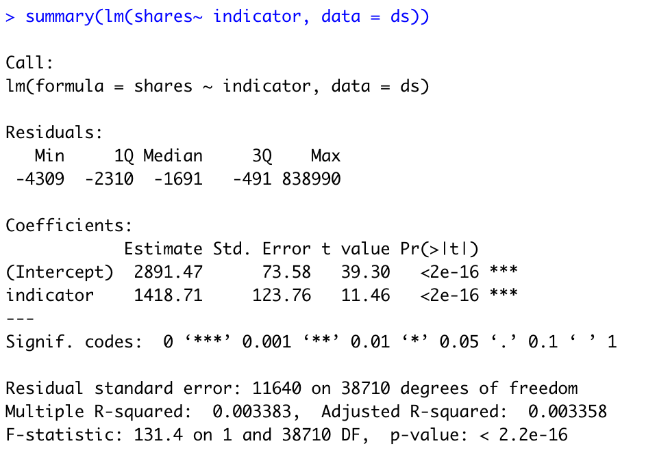
Causal estimate
Correlational estimate
All p-value from the causal and correlational estimate is less than the standard p-value threshold 0.05, which we can conclude there is a positive relationship between shares and videos number.

Slide 10
# b. The difference between the two estimates, causal and correlational is large and implies a same directional conclusion. Whereas the correlational estimate would suggest that video number leads to more shares, the causal estimate implies a higher shares by about 1514.1.

Slide 11
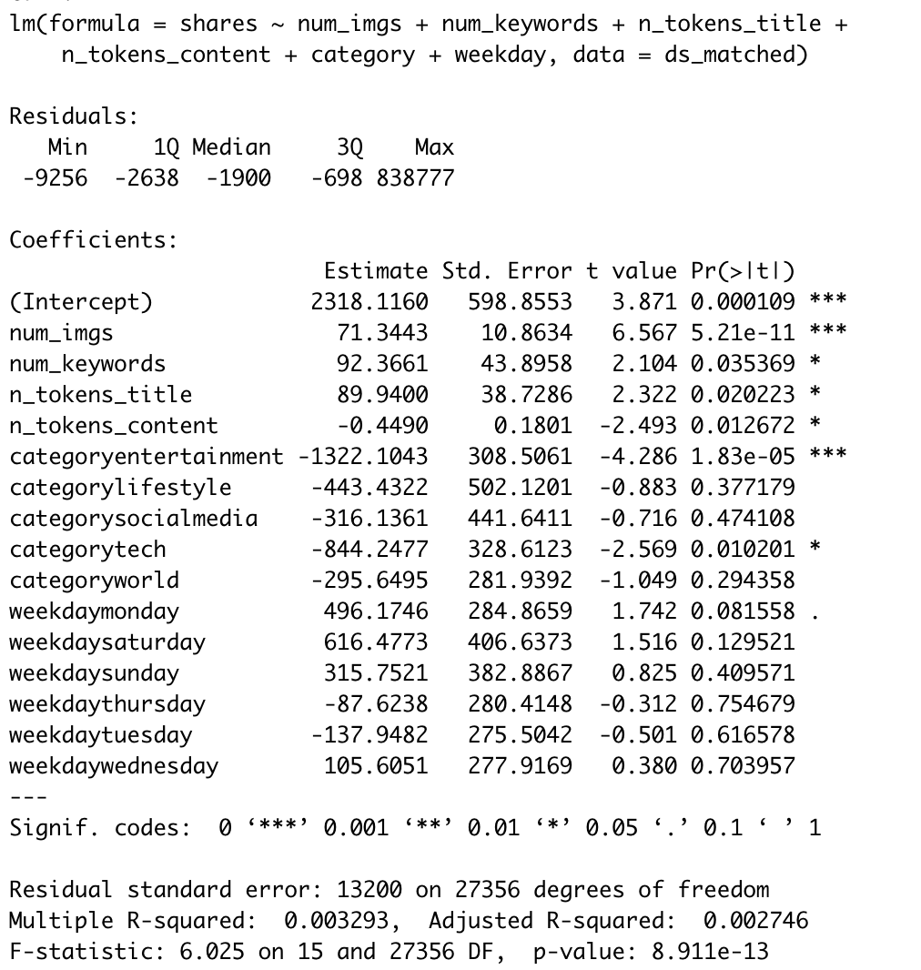
We reproduce the matching estimate but adding controls to the regressions.
We’ve noticed adding controls changes the correlational estimate a lot.
The causal estimate is very similar to the one we got before. This is a sign that our matching was successful.

Slide 12
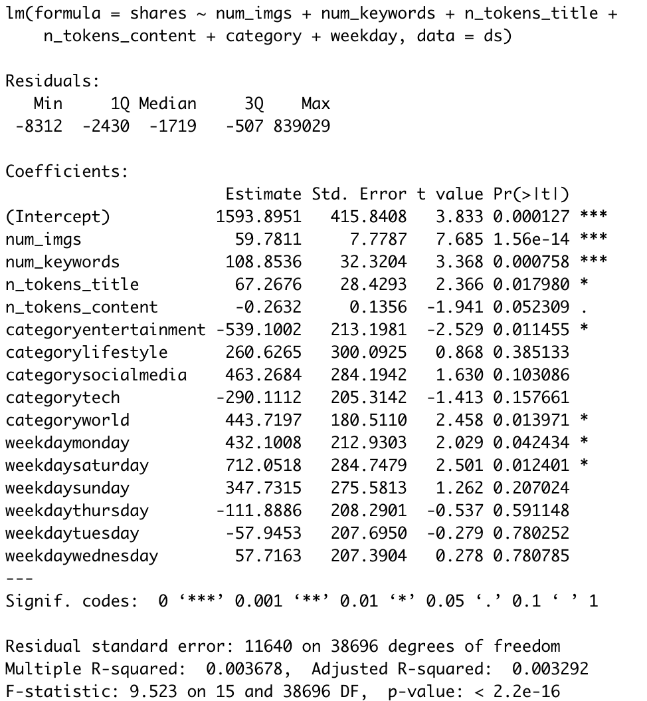
Next, we test how important the issue of weak overlap may be for our estimates.
We do so by estimating the matching estimate only using observations in the region of good overlap.
Our key result does not change by much. We conclude that weak overlap does not drive our result.

Slide 13
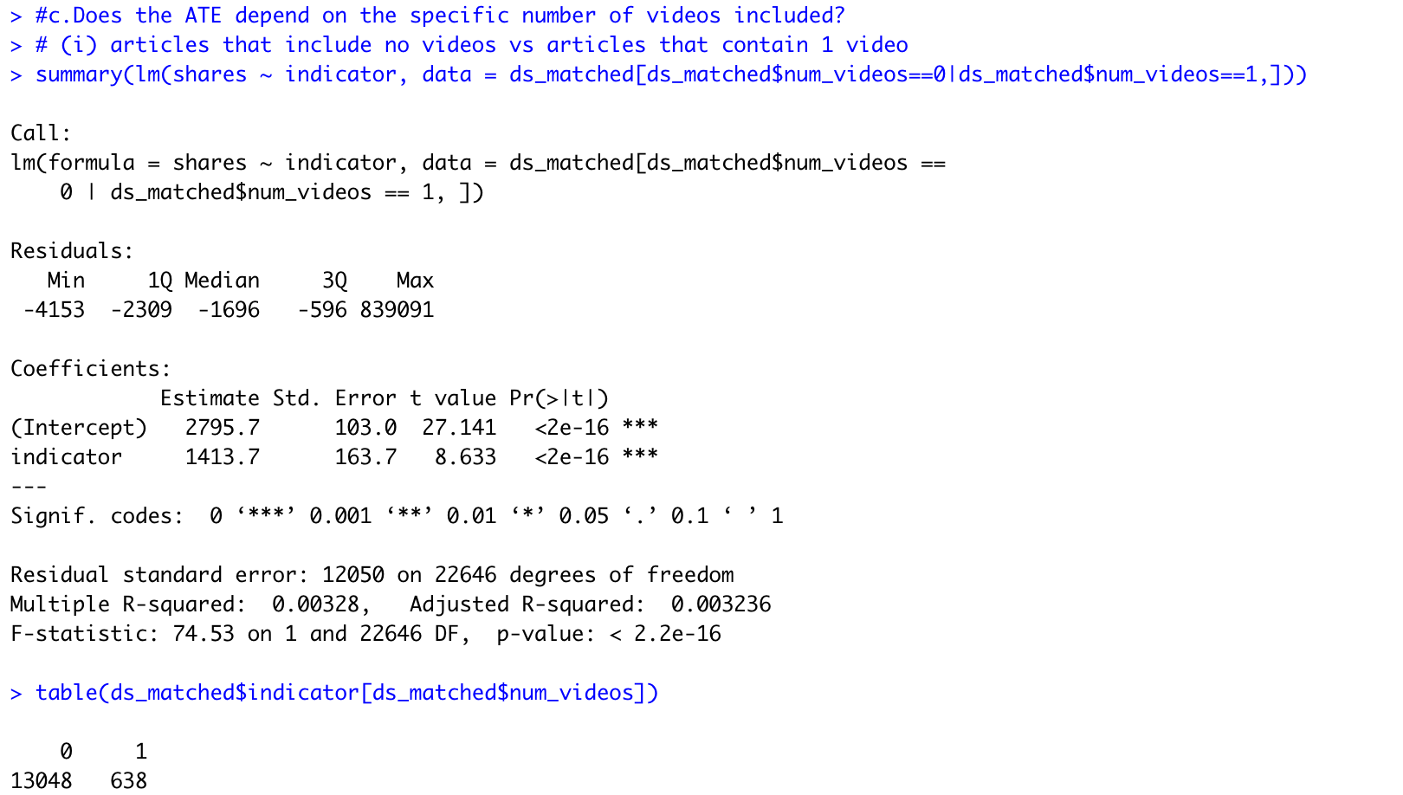
As can be seen from the left side, the ATE estimation only using observations for no video and one video from the sample we matched before.
The estimated ATE is 1413.7, which is similar to the ATE 1418.71 from the full sample .

Slide 14
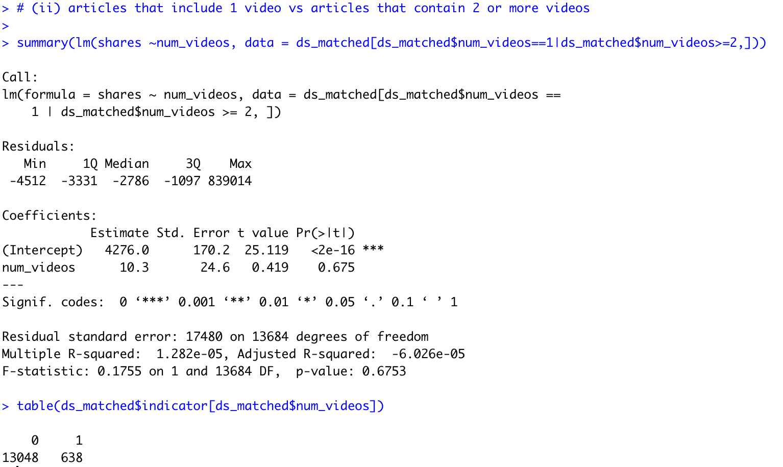
As can be seen from the left side, the ATE of videos equal to one is already higher than those do not have video, while the coefficient shows that after having one video, the increased tendency is lesser, which the ATE is only 10.3.
It can imply increasing video is unnecessary.

